Slide 1
Lecture 2
Lecturer: Emmanuel Isabirye

Slide 2
THE ACCOUNTING EQUATION
What the business has as its assets must have come from some where perhaps contributed by the owners (capital).
Therefore:
Assets of the business = Capital contributed by the owners.
Usually however, people other than the owners supply some assets to the business. Liabilities are the name given to those assets that are supplied to a business by the people other than the owners.

Slide 3
Cont.
The equation can then be adjusted to become
Assets = Capital + liabilities
The value of the assets, capital or liabilities may change but the total of the assets will always equal the total of capital plus liabilities.
Assets consist of property of all kinds such as buildings, machinery, stocks, cash, motor vehicles, debtors, money in the bank etc.
Liabilities include amounts owed by the business for goods and services supplied and for expenses incurred that have not been paid for and funds borrowed by the business.

Slide 4
Cont.
Capital is often called the owner’s equity or the net worth. It comprises the funds invested in the business by the owner plus any profits made and retained for use in the business less any profits paid out of the business to the owners.
The accounting equation is expressed in a financial position statement called the balance sheet.

Slide 5
Cont.
The balance sheet shows the financial position of an organization at a point in time. The balance sheet shows the assets of the business less the liabilities which equals the net worth of the business (capital)

Slide 6
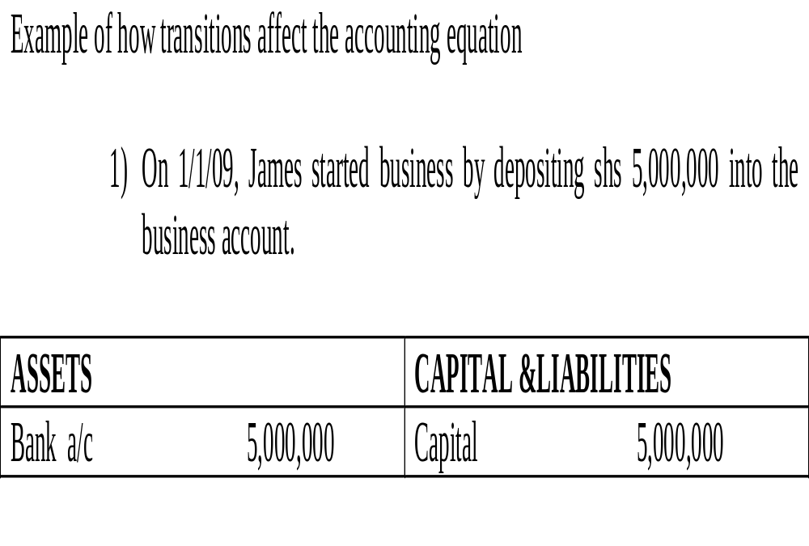
Cont.

Slide 7
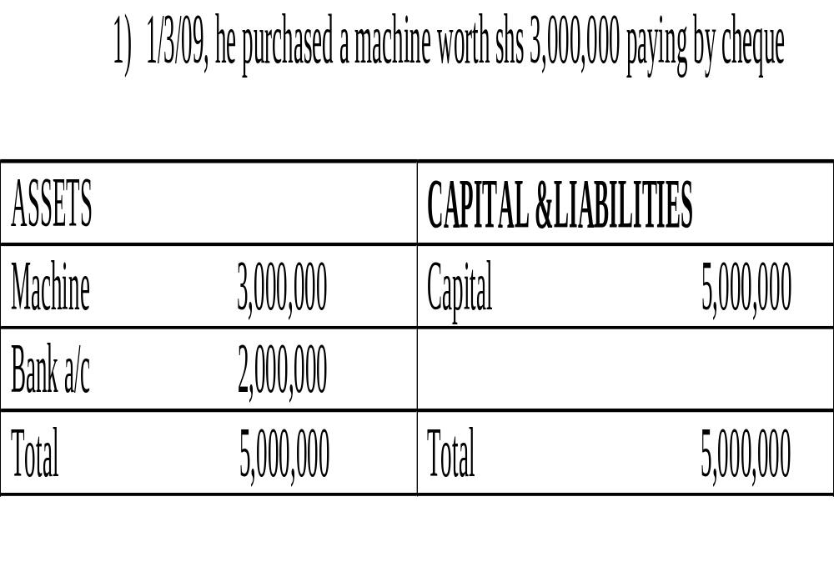

Slide 8
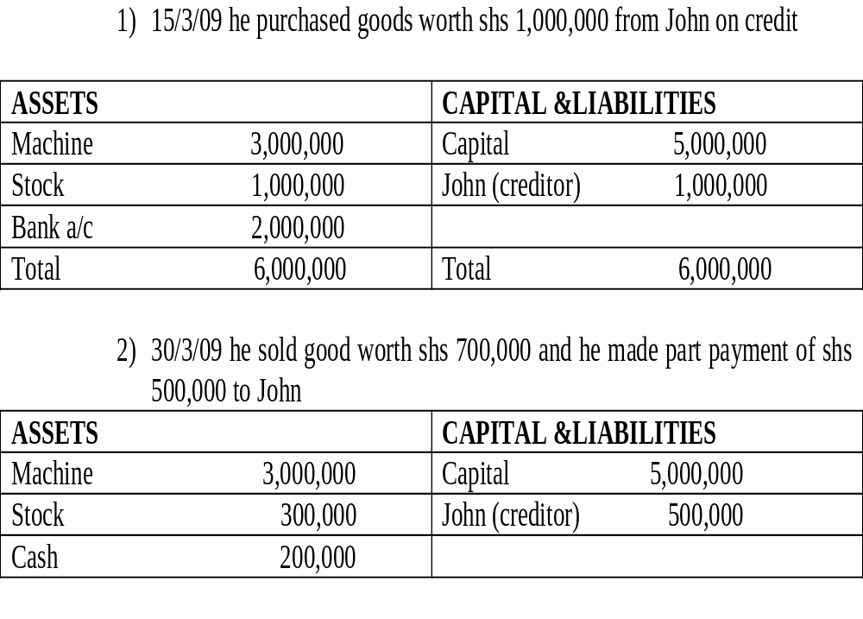

Slide 9
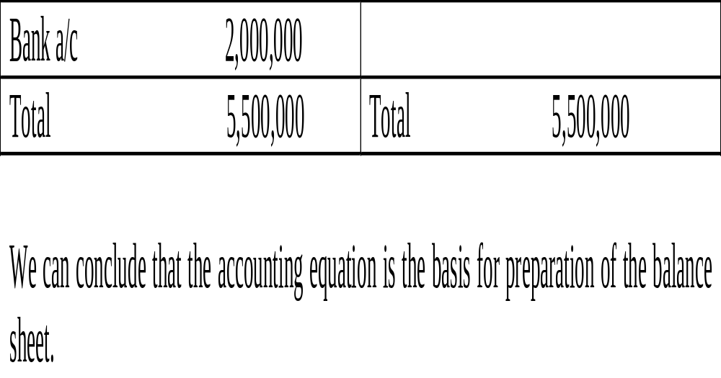
Cont.

Slide 10
Cont.
THE ACCOUNTING CYCLE
The accounting process is done in steps from the point when a transaction is done to when the final financial statements are made. The following are the steps in the accounting cycle:
Occurrence & documentation:
Source documents where the original information is to be found such as sales and purchases invoices, debit and credit notes for good returned, bank pay in slips and cheque counter folios, receipts books issued out and receipts for cash paid out, and other correspondences containing financial information.

Slide 11
Cont,
Journal entry:
Original entry where information is classified and entered in the different books of original entry such as cash books, sales and purchases day books, return in wards and return out wards day books and journals.
Posting in the ledger:
The double entry which shows how the double entry aspect of each transaction is recorded. This is done in T – accounts called ledgers.

Slide 12
Extraction of the trial balance where the ledgers are summarized and arithmetic errors checked.
Make end of year adjustments to the TB.
Income statement where the profit or loss for the period is determined.
Preparation of a balance sheet to show the closing financial position showing assets, liabilities and capital
Interpretation of financial statements.

Slide 13
BOOKS OF PRIME ENTRY/SINGLE ENTRY/ PRIMARY ENTRY
These are books in which we first record transactions from the original documents. They include sales day book, purchases day book, return in wards day book, return out wards day book, the cash book and the journal.

Slide 14
SALES DAY BOOK/SALES JOURNAL
This is where sales made on credit are recorded on daily basis. When goods are sold on credit, a document called an invoice is sent to the buyer. The invoice contains the details of the good, i.e. the quantity, price per unit and total selling price. From the copy of the sales invoice, the seller enters up the transaction in the sales day book.
The sales day book contains the date of the sale, name of customer, invoice number, folio column and final amount of the invoice.

Slide 15
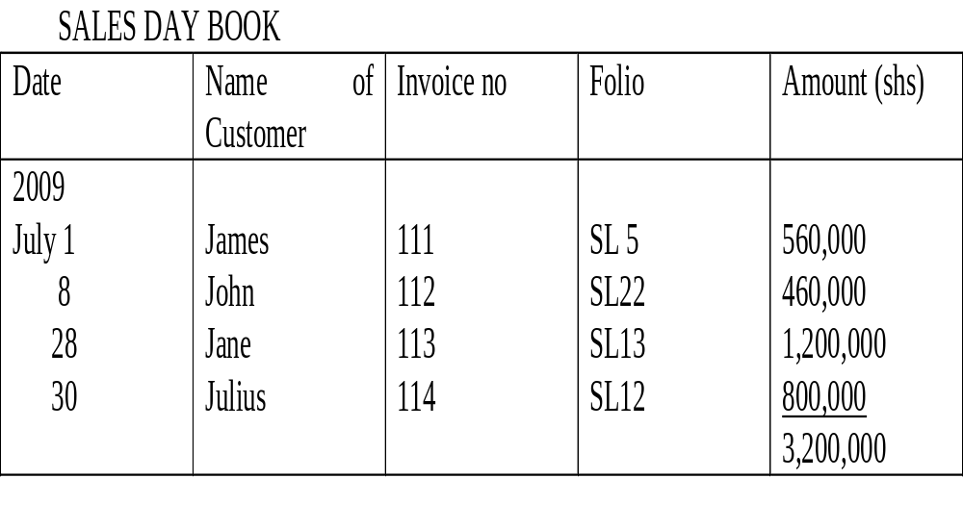
Example:

Slide 16
PURCHASES DAY BOOK
Like for credit sales, when you purchase goods on credit, the seller prepares an invoice and sends it to you. The invoice is called the purchases invoice.
From the purchases invoice, the purchasers enters the details of the goods purchased in the purchases day book also called purchases journal.

Slide 17
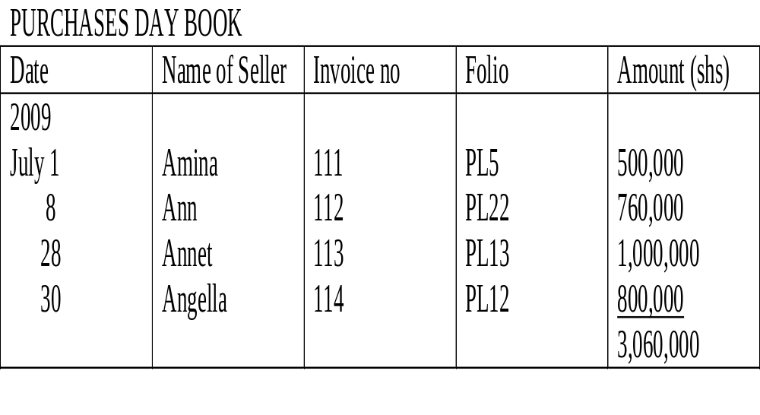
Example

Slide 18
RETURN DAY BOOKS
When good are purchased or sold on credit, they may be returned for reasons that they are not of the right quality or they do not meet the customer’s description. Such good returned are recorded in return day books.
Goods that were sold but have been returned are called return in wards and are recorded in return in words day book (journal)
Goods that were purchased but are being returned to the suppliers are called return out wards and are recorded in return outward day book (journal).

Slide 19
RETURN INWARD Day BOOK
When goods have been returned by customers, a document called a credit note is sent to them acknowledging the goods that have been returned and indicating that their account will be credited (reduced) by the value of the goods that have been returned.
The copies of the credit notes are then used to enter the details of the goods that have been returned in the return inward day book.

Slide 20
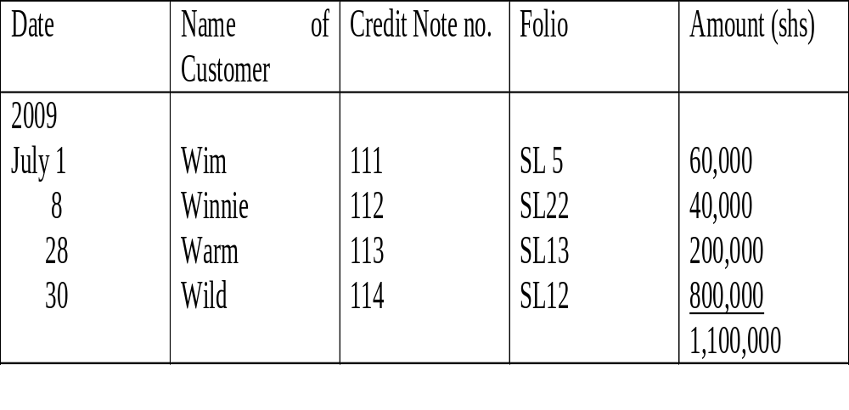
Example
RETURN INWARD DAY BOOK

Slide 21
RETURN OUTWARD DAY BOOK
When good that had been purchased are returned to the supplier, a document called a debit note is sent to the supplier describing the goods that have been returned to him and notifying him that his account Has been debited (reduced) by the value of the goods returned.
The credit notes are then used to enter the details of the goods returned in the return outward day book.

Slide 22
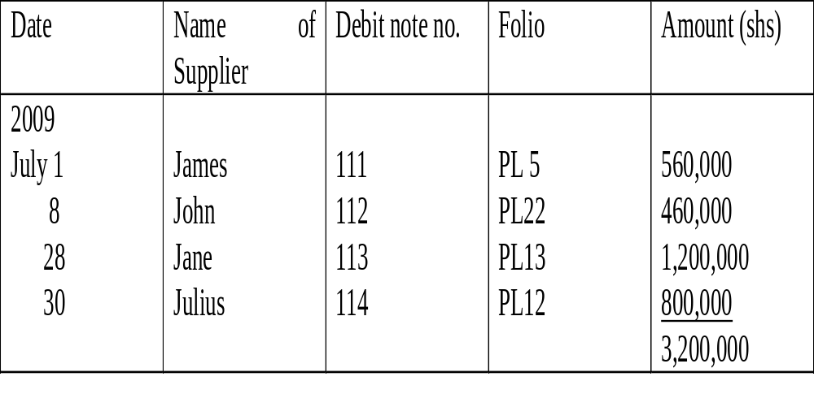
Example
RETURN OUTWARD DAY BOOK

Slide 23
THE CASH BOOK
The cash book records cash and cheque transactions. The left hand side records receipt of cash and cheques and right hand side records payments of cash and cheques.
A typical cash book will have the date of the transaction, name of the person paying, the cash and bank column on the left hand side and date, name of person being paid, cash and bank column on the right hand side.
However a detailed cash book may contain the folio and the discounts column on both sides. The folio column gives reference of the other account where the transaction has been recorded. The discount columns record discounts allowed on the left hand side and the discounts received on the right hand side.

Slide 24
Example:
The following were the bank and cash transactions of JB ltd.
2009 July 1 JB banks capital into the bank account of 10,000,000
2 Received a cheque from Jim shs 560,000
4 Sold good in cash shs 1,200,000
6 Paid rent by cash shs 800,000
8 Bank shs 300,000 into the bank account
16 Sold goods by cheque shs 600,000
23 paid John by cheque shs 1,000,000
26 Withdrew cash from the bank for business use shs 1,500,000
30 Paid wages in cash shs 1,000,000.
Draw up the cash for JB ltd. For the month of July 09.

Slide 25
Cont,
JB Ltd. Cash book for the month of July 09
Date | Part. | Folio | Cash | Bank | Date | part | Folio | Cash | Bank
Jul 09 1 2 4 8 16 26 | Capital Jim Sales Cash Sales bank | GL Jim SL C SL C | 1,200,000 1,500,000 | 10,000,000 560,000 300,000 600,000 | Jul 09 6 8 23 26 30 31 | Rent Bank John Cash Wages Bal | GL C GL C GL C/D | 800,000 300,00 1,000,000 600,000 | 1,000,000 1,500,000 8,960,000
 |  |  | 2,700,000 | 11,460,000 |  |  |  | 2,700,000 | 11,460,000
Aug 1 | Bal | B/F | 600,000 | 8,960,000

Slide 26
Cont,
Example of a cash book with discounts column
Dec 08
1 Bal b/f from Nov cash shs 29,000 and bank shs 654,000.
Accounts receivable are John shs 120,000, Jimmy shs 280,000 and Jackie shs 40,000.
Accounts payable are Alice shs. 60,000, Annet shs 440,000 and Allen shs 100,000.
2 John pays by cheque having deducted 2.5% cash discount
We pay Allen her account by cheque deducting 5% cash discount.
11 We withdrew shs 100,000 cash from the bank for business use.
16 Jimmy pays us his account by cheque deducting 2.5% cash discount.

Slide 27
Cont,
25 We paid office expenses in cash shs 92,000.
28 Jackie pays us in cash having deducted 5% cash discount.
29 We pay Alice by cheques less 5% cash discount.
30 We pay Annet by cheque less 2.5% cash discount.
Prepare a cash book for the month of Nov 08.

Slide 28
ANALYTICAL PETTY CASH BOOK
As the business grows bigger, there are some small payments that it makes that if put in the main cash book, would make it more difficult to identify the important transactions that the business need to keep a close eye upon. A petty cash book is therefore used to record and analyse those small transaction.
Usually, an imprest system is used where the main cashier gives the petty cashier enough cash to meet the petty cash needs for the period of time. At the end of the period, the main cashier finds out how much the petty cashier has spent and he reimburses the amount equal to what the petty cashier has spent so as to put him in his original cash position as he was in the beginning.

Slide 29
Cont,
The main advantages of petty cash system are:
The main cashier is relieved from the task of recording small cash payments.
The main cash book is not congested by the small petty payments

Slide 30
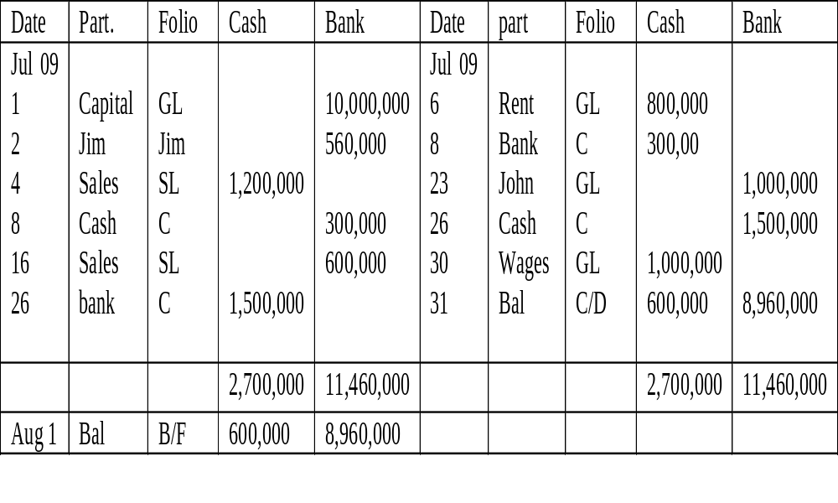
LAY OUT OF A PETTY CASH BOOK

Slide 31
PROCEDURE
Enter the data and details of each payment. Put the amount paid in the total column.
Put the same amount in the column for that type of expense
At the end of the period, add up the total column.
Add up each of the expense column. The total found at step three should be equal to the total of all expense columns
Enter the amount reimbursed to make up the float in the receipt column.
Balance off the petty cash book carrying down the petty cash in hand to the next period.
The last column of the petty cash book is a ledger column which contains items paid out of petty cash which need posting to the ledger other than the general ledger e.g. if purchases ledger is settled out of petty cash.

Slide 32
Example:
Enter the following in a petty cash of MJ Schools Ltd.
2008 Dec 1 The head teacher gives shs 300,000 as a float for petty cash.
Payment out of the petty cash are as follows:
2 Vr no 1 petrol for the school bus shs 16,000.
3 Vr. No 2 paid Green traveling expenses of shs 23,000.
3 Vr. No 3 paid postage shs 12,000.
4 Vr. No 4 paid Davis traveling exp shs 32,000.
7 Vr. No. 5 Paid for cleaning expenses shs 11,000.
8 Vr. No. 6 petrol for the school bus.
12 Vr.no 7 Paid Jonnes traveling exp shs 13,000.
14 Vr. No 8 Bought petrol for the school bus shs 23,000.
15 Vr. No 9 Paid Black traveling expenses of shs 5,000.
16 Vr. No. 10 paid for cleaning services shs 11,000.

Slide 33
Cont,
17 Vr. No. 11 Bought petrol for the school bus shs 22,000.
20 Vr. No. 12 Paid for postage shs 12,000.
21 Vr. No. 13 Paid for cleaning services shs 11,000.
22 Vr. No 14 Paid wood traveling expenses shs 7,000.
27 Vr. No. 15 settled Browns account in purchases ledger shs 13,000.
28 Vr. No. 16 paid for postage shs 12,000.
29 The Head teacher reimbursed the petty cashier the cash spent for the month.

Slide 34
COLUMNAR DAY BOOKS
Some organizations use only one book to record all purchases on credit including purchases of good for resale, stationery, motor expenses and other non current assets. These are recorded in Columnar purchases day book also known as purchase analysis book.
Similarly, organizations may record all their credit sales by section or product or division. It does this in the columnar sales day book also know as sales analysis book.

Slide 35
COLUMNAR PURCHASES DAY BOOK (PURCHASE ANALYSIS BOOK)
Exple: The following were the purchases of GT ltd:
May 09
1 Bought goods from Watson on credit shs 2,500,000.
5 James Garage repaired the van on credit shs 300,000.
9 Bought goods from John on credit shs 1,000,000.
15 Lorry was serviced by Walusimbi Garage on credit shs 500,000.
20 Bought packing materials on credit shs 150,000 from Hellen.
30 Received invoice for carriage in wards on goods from Annet shs 250,000.

Slide 36
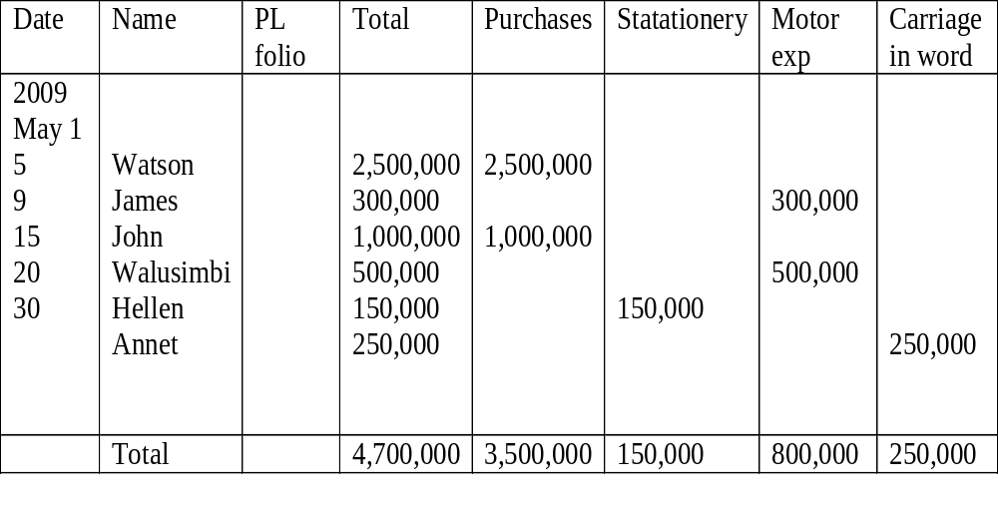
Cont,
Prepare a columnar purchases day book

Slide 37
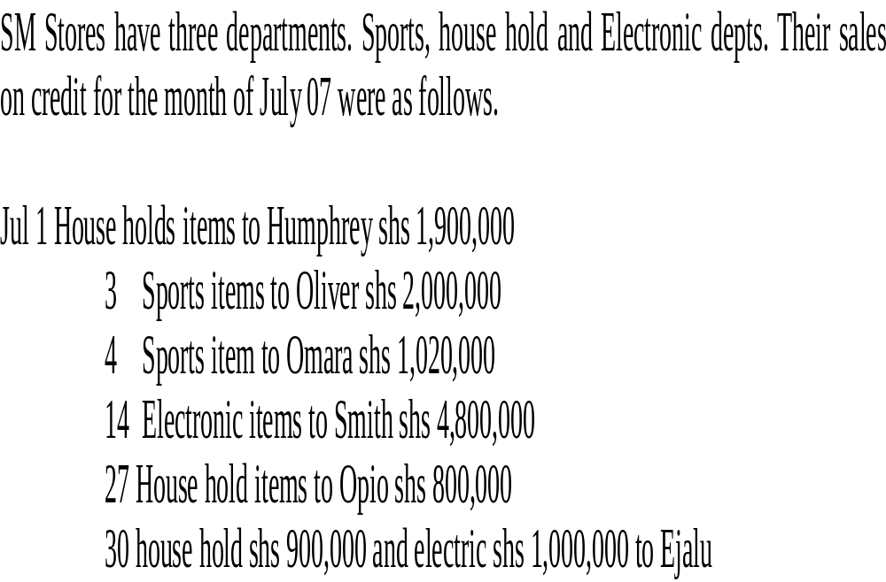
COLUMNAR SALES DAY BOOK

Slide 38
Cont,
Prepare columnar sales day book

Slide 39
Cont,
OTHER BOOKS OF PRIME ENTRY INCLUDE
Value added tax book for recording VAT transactions
The employees pay for recording wages of employees.

